Slide 1
CALIPTRA SoC IFC Microarchitecture-Phase 1
V.SRAVANTHI
DESIGN ENGINEER
CHIPWEAVE TECHNOLOGIES PVT LTD

Slide 2
CONTENTS
High level Block Diagram of Caliptra
SoC-Interface Introduction & Block Diagram
Mailbox Introduction & Block Diagram
Signal list and working of Mailbox
SHA 512 Accelerator Introduction & Block Diagram
Signal list and working of SHA 512 Accelerator

Slide 3
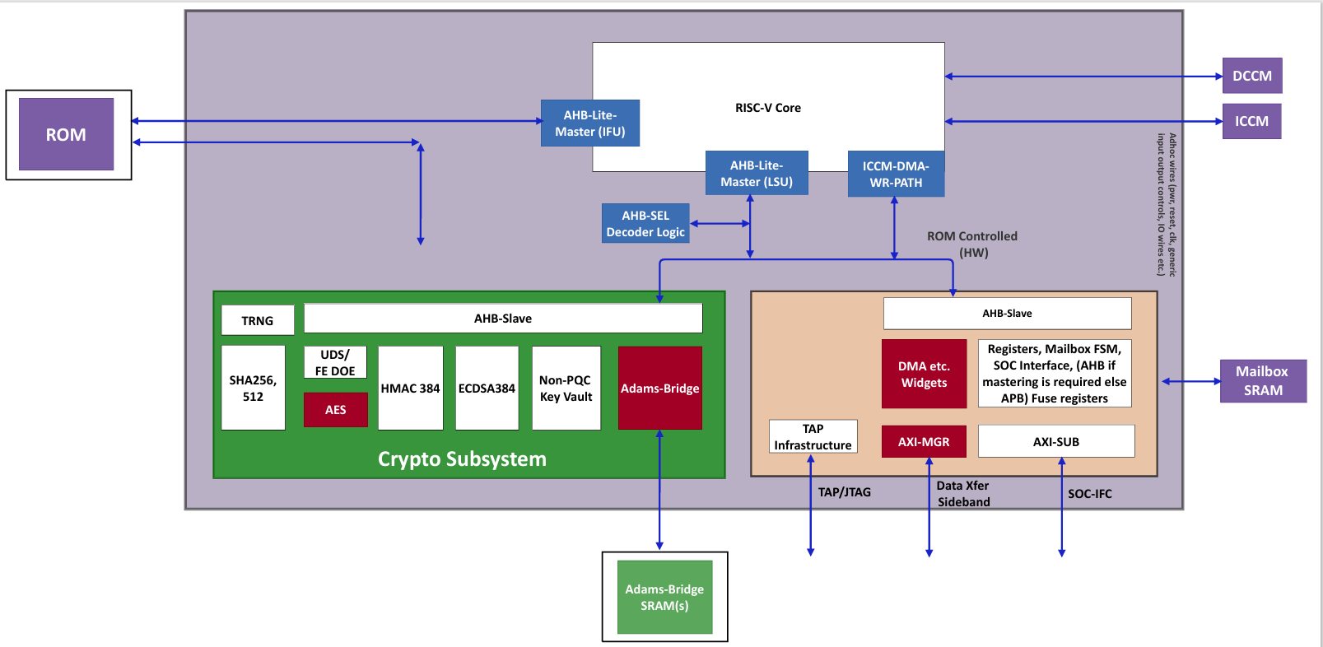
High Level Block Diagram of Caliptra

Slide 4
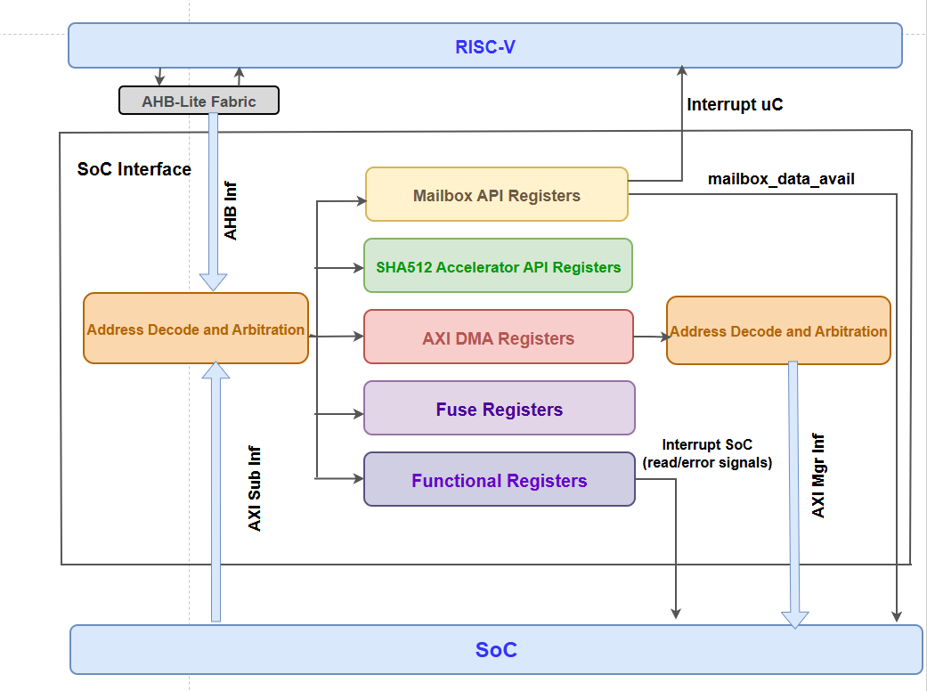
Block Diagram of SoC-IFC

Slide 5
Mailbox
The mailbox is a hardware communication block used to exchange data between SoC, uC, DMA, and SHA accelerator.
It uses a finite state machine (FSM) to control the sequence:
IDLE → CMD → DLEN → DATA → EXECUTE.
A lock mechanism ensures only one master (SoC, uC, or TAP) accesses the mailbox at a time.
Data is stored in an internal SRAM memory, organized using read and write pointers.
The CSR registers (CMD, DLEN, STATUS, DATA) control mailbox configuration and operation.

Slide 6
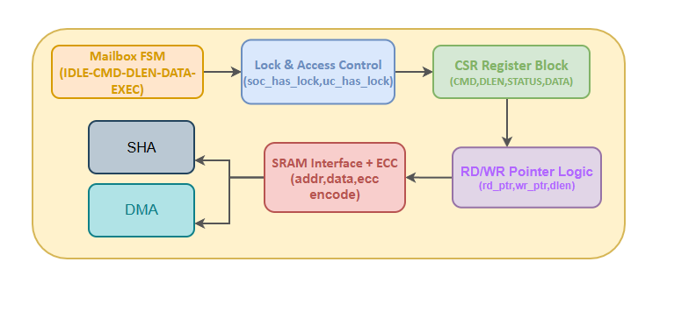
Block Diagram of Mailbox
Fig 1.Block Diagram of Mailbox

Slide 7
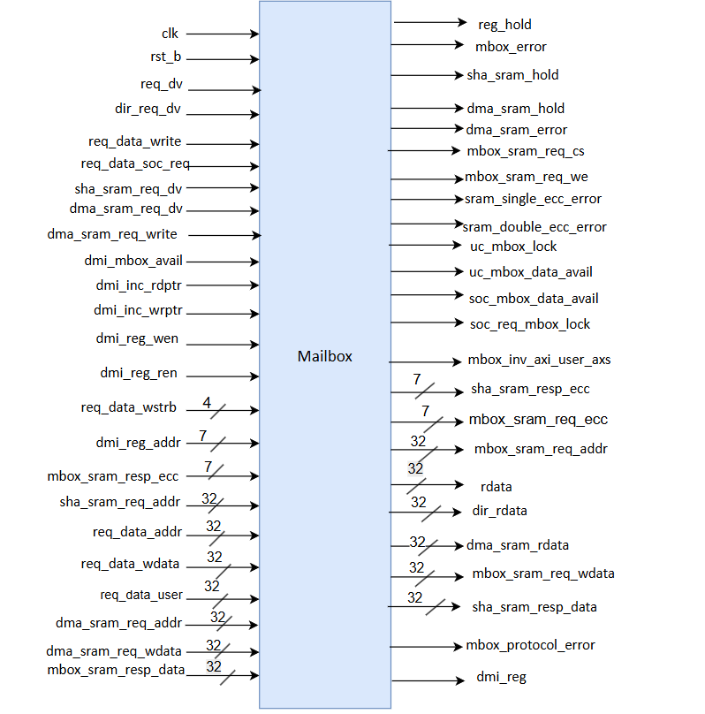
Pin Diagram of Mailbox
Fig 2.Pin Diagram of Mailbox

Slide 8
Mailbox Input Signal Description
Table 1. Mailbox Input Signal Description
Signal Name | Width | Direction | Description
clk | 1 | Input | System clock
rst_b | 1 | Input | Active low reset
req_dv | 1 | Input | Request valid signal
dir_req_dv | 1 | Input | Direct access request
req_data_write | 1 | Input | Write enable signal
req_data_soc_req | 1 | Input | Indicates SoC request
sha_sram_req_dv | 1 | Input | SHA SRAM request valid
dma_sram_req_dv | 1 | Input | DMA request valid
dma_sram_req_write | 1 | Input | DMA write enable
dmi_mbox_avail | 1 | Input | DMI mailbox availability
dmi_inc_rdptr | 1 | Input | Increment read pointer
dmi_inc_wrptr | 1 | Input | Increment write pointer
dmi_reg_wen | 1 | Input | DMI register write enable

Slide 9
Mailbox Input Signal Description(Contd..)
Table 2. Mailbox Input Signal Description
Signal Name | Width | Direction | Description
dmi_reg_ren | 1 | Input | DMI register read enable
req_data_wstrb | 4 | Input | Byte-wise write strobe
dmi_reg_addr | 8 | Input | DMI register address
mbox_sram_resp_ecc | 8 | Input | ECC bits read from SRAM
sha_sram_req_addr | 32 | Input | Address for SHA access
req_data_addr | 32 | Input | Request address
req_data_wdata | 32 | Input | Write data
req_data_user | 32 | Input | AXI user ID
dma_sram_req_addr | 32 | Input | DMA request address
dma_sram_req_wdata | 32 | Input | DMA write data
mbox_sram_resp_data | 32 | Input | Data read from SRAM

Slide 10
Mailbox Output Signal Description
Table 3. Mailbox Output Signal Description
Signal Name | Width | Direction | Description
req_hold | 1 | Output | Stall signal to hold request
mbox_error | 1 | Output | Read/write error indication
sha_sram_hold | 1 | Output | Hold signal for SHA access
dma_sram_hold | 1 | Output | Hold signal for DMA access
dma_sram_error | 1 | Output | DMA error indication
mbox_sram_req_cs | 1 | Output | SRAM chip select
mbox_sram_req_we | 1 | Output | SRAM write enable
sram_single_ecc_error | 1 | Output | Single-bit ECC error detected
sram_double_ecc_error | 1 | Output | Double-bit ECC error detected
uc_mbox_lock | 1 | Output | uC owns mailbox lock
uc_mbox_data_avail | 1 | Output | Data available for uC
soc_mbox_data_avail | 1 | Output | Data available for SoC
soc_req_mbox_lock | 1 | Output | SoC requesting mailbox lock

Slide 11
Mailbox Output Signal Description(Contd..)
Table 4 . Mailbox Output Signal Description
Signal Name | Width | Direction | Description
mbox_inv_axi_user_axs | 1 | Output | Invalid AXI access detected
sha_sram_resp_ecc | 8 | Output | ECC response to SHA
mbox_sram_req_ecc | 8 | Output | ECC bits generated for SRAM write
mbox_sram_req_addr | 32 | Output | Address to SRAM
rdata | 32 | Output | Read data output
dir_rdata | 32 | Output | Direct read data
dma_sram_rdata | 32 | Output | DMA read data
mbox_sram_req_wdata | 32 | Output | Data written to SRAM
sha_sram_resp_data | 32 | Output | Data returned to SHA
mbox_protocol_error | 64 | Output | Mailbox protocol error information
dmi_reg | 64 | Output | DMI register output bundle

Slide 12
Mailbox Working
The Mailbox is a hardware communication block used for data exchange between the SoC, microcontroller (uC), DMA, and SHA engine.
It works like a shared memory system where one module writes data and another module reads the data.
The mailbox operation is controlled using a lock mechanism and FSM to avoid conflicts and maintain proper communication flow.
Only one requester can access the mailbox at a time, which helps maintain data integrity and synchronization.

Slide 13
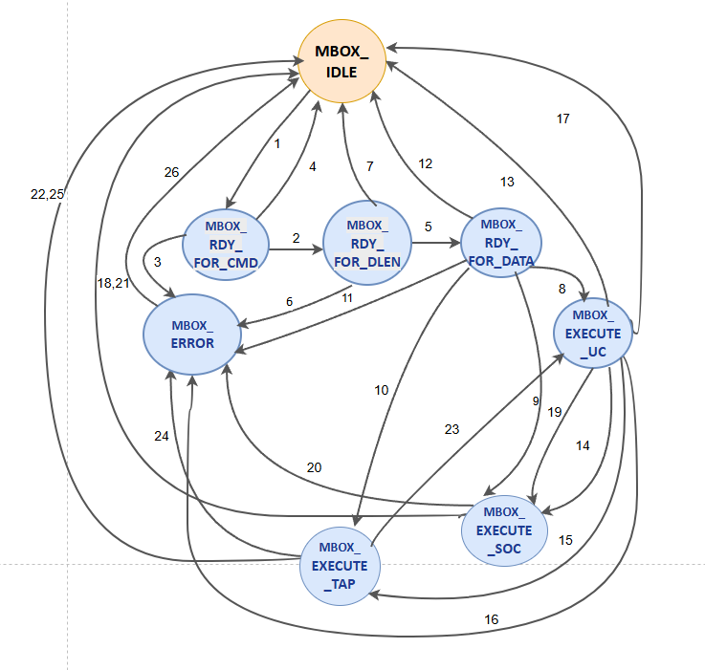
Mailbox Working(Contd..)
Finite State Machine (FSM)
The FSM controls the complete mailbox operation.
It moves through different states such as:
IDLE
Ready for Command
Ready for Data Length
Ready for Data
Execute State
Each state ensures that mailbox operations happen in the correct order.
The FSM prevents invalid accesses and enforces mailbox communication rules.
Fig 3.Mailbox FSM

Slide 14
Mailbox Working(Contd..)
Lock Mechanism
The mailbox uses lock signals such as:
soc_has_lock
uc_has_lock
tap_has_lock
Only the requester holding the lock is allowed to access the mailbox.
Before performing read or write operations, the requester must first acquire the mailbox lock.
This mechanism prevents simultaneous access and protects data consistency.

Slide 15
Mailbox Working(Contd..)
Request Validation
The mailbox validates all incoming requests using signals such as:
valid_requester
valid_receiver
A request is accepted only if it comes from the current lock owner.
The request must also match the expected mailbox operation phase.
Invalid or unauthorized accesses are blocked and reported as errors.
Ready for Command
Ready for Data Length
Ready for Data
Execute State
Each state ensures that mailbox operations happen in the correct order.
The FSM prevents invalid accesses and enforces mailbox communication rules.

Slide 16
Mailbox Working(Contd..)
CSR Register Block
The mailbox contains several control and status registers.
Important registers include:
Command Register
Data Length Register
Execute Register
Status Register
These registers are used to configure mailbox operations and monitor mailbox status.
They also provide a software interface for controlling mailbox communication.

Slide 17
Mailbox Working(Contd..)
Data Storage (SRAM Interface)
The mailbox uses internal SRAM memory for storing transferred data.
Write operations store data into SRAM, while read operations retrieve data from SRAM.
The SRAM interface contains address, data, and ECC signals.
This interface ensures reliable and organized data storage.
Read/Write Pointer Logic
The mailbox maintains separate read and write pointers:
mbox_rdptr
mbox_wrptr
The write pointer increments whenever new data is written into SRAM.
The read pointer increments whenever data is read from SRAM.

Slide 18
Mailbox Working(Contd..)
Multi-Master Arbitration
The mailbox supports multiple masters such as:
SHA
DMA
CPU
Microcontroller
Arbitration logic decides which master gets mailbox access.
SHA requests are usually given the highest priority.
DMA requests are handled next, followed by direct software accesses.

Slide 19
Mailbox Working(Contd..)
ECC (Error Correction Code)
ECC logic improves memory reliability.
ECC bits are generated whenever data is written into SRAM.
During read operations, ECC is checked for possible memory errors.
Single-bit errors can be corrected, while multi-bit errors can be detected.
Interrupt and Status Signals
The mailbox generates interrupt and status signals during operation.
These signals indicate:
Data availability
Lock ownership
Mailbox status
Interrupts help notify the processor when mailbox operations are completed.
Status signals help coordinate communication between sender and receiver.

Slide 20
Mailbox Working(Contd..)
Error Handling and Protocol Checks
The mailbox detects invalid operations and protocol violations.
Errors may occur due to:
Incorrect access order
Access without lock ownership
Invalid requests
Such invalid operations are flagged using dedicated error signals.
This helps maintain correct and secure mailbox functionality.

Slide 21
Mailbox Working(Contd..)
Hold / Stall Logic
Hold signals such as:
req_hold
dma_sram_hold
are used to temporarily stall requests.
Requests may be stalled when:
Resources are busy
Higher-priority accesses are active
Stall logic helps synchronize operations between different masters.
This ensures safe and orderly access to shared resources.

Slide 22
SHA512 Accelerator
The SHA512 Accelerator in the SoC Interface (SoC IFC) of Caliptra is a dedicated hardware module designed to perform high-speed SHA-512 and SHA-384 cryptographic hash operations.
It enables secure and efficient message digest generation for firmware authentication, integrity verification, and secure boot processes.
The accelerator supports both streaming mode and mailbox mode for flexible data input handling.
It includes internal control FSMs, padding logic, block buffers, and a SHA512 compression core to process 1024-bit message blocks.

Slide 23
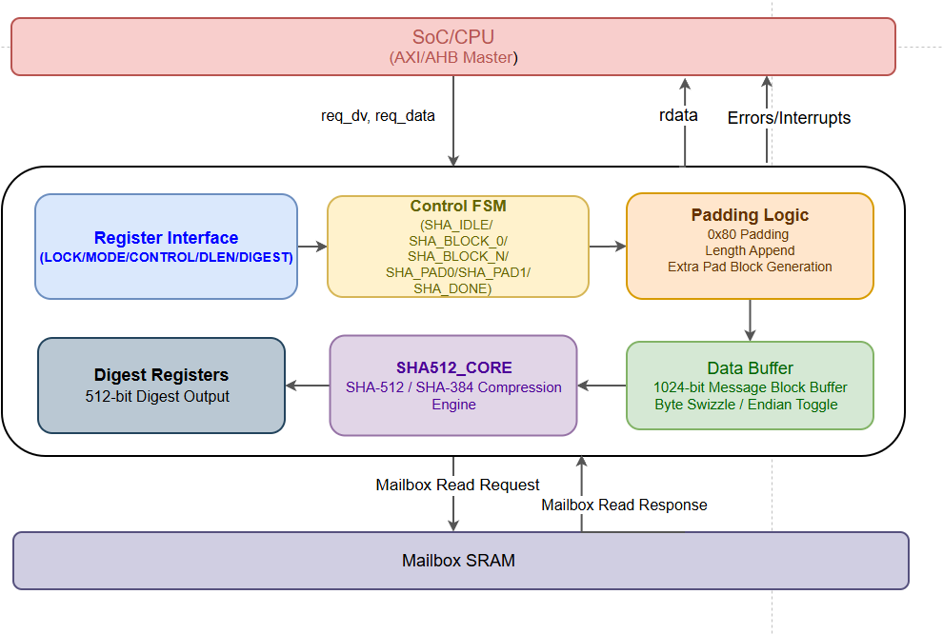
Block diagram of SHA512 Accelerator
Fig 4.Block Diagram of SHA512 Accelerator

Slide 24
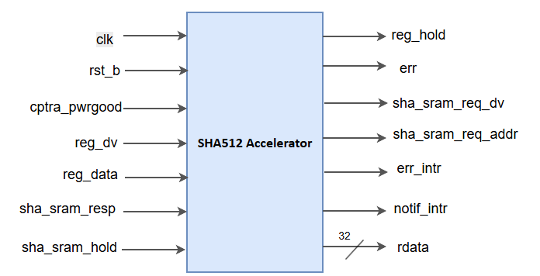
Pin diagram of SHA512 Accelerator
Fig 5.Pin Diagram of SHA512 Accelerator

Slide 25
SHA512 Accelerator Input Signal Description
Table 5.Inputs of SHA512 Accelerator
Signal Name | Width | Direction | Description
clk | 1 | Input | System clock
rst_b | 1 | Input | Active low reset
cptra_pwrgood | 1 | Input | Power-good signal
req_dv | 1 | Input | Request valid signal
sha_sram_hold | 1 | Input | SRAM hold/stall signal
sha_sram_resp | 32 | Input | Mailbox SRAM read response
req_data | 32 | Input | AXI/AHB request packet

Slide 26
SHA512 Accelerator Output Signal Description
Table 6. Outputs of SHA512 Accelerator
Signal Name | Width | Direction | Description
req_hold | 1 | Output | Stall request
err | 1 | Output | Error indicator
sha_sram_req_dv | 1 | Output | Mailbox read enable
error_intr | 1 | Output | Error interrupt
notif_intr | 1 | Output | Completion interrupt
sha_sram_req_addr | 32 | Output | Mailbox read address
rdata | 32 | Output | Read data

Slide 27
SHA512 Accelerator Working
The sha512 Accelerator is a hardware-based SHA accelerator used in Caliptra to generate secure SHA-512 or SHA-384 hashes.
Initially, software acquires ownership of the SHA engine using the LOCK register. This prevents unauthorized access while a hashing operation is in progress.
Once the lock is obtained, the operating mode and SHA algorithm are selected using the MODE register.
Mode Value | SHA Mode | Description
2'b00 | SHA384 Streaming Mode | Performs SHA-384 hashing in streaming mode. Data is processed continuously from the input stream.
2'b01 | SHA512 Streaming Mode | Performs SHA-512 hashing in streaming mode. Supports continuous data hashing operation.
2'b10 | SHA384 Mailbox Mode | Performs SHA-384 hashing using mailbox data. Valid only for Caliptra internal requests and invalid for SoC requests.
2'b11 | SHA512 Mailbox Mode | Performs SHA-512 hashing using mailbox data.

Slide 28
SHA512 Accelerator Working(Contd..)
The padded message blocks are then processed by the instantiated sha512 core. The SHA core performs multiple compression rounds internally and generates the final digest value.
The computed digest is stored inside digest registers and can be read by software through the register interface.

Slide 29
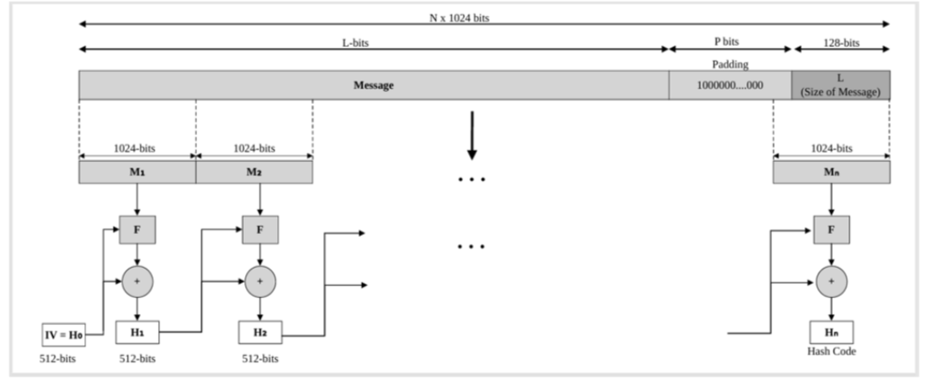
SHA512 Accelerator Working(Contd..)
The padded message blocks are then processed by the instantiated sha512 core. The SHA core performs multiple compression rounds internally and generates the final digest value.
The computed digest is stored inside digest registers and can be read by software through the register interface.

Slide 30
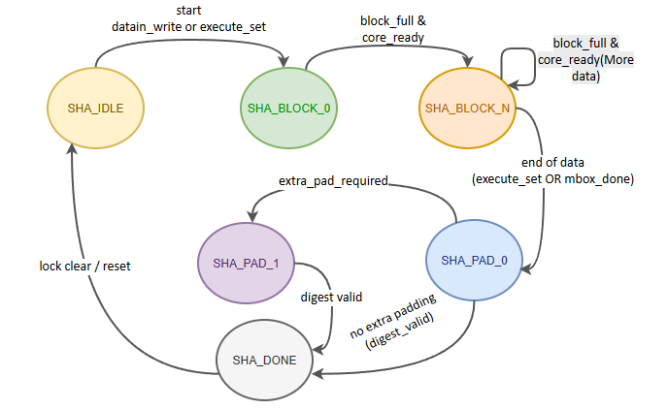
SHA512 Accelerator Working(Contd..)
Throughout the operation, the FSM transitions through multiple states such as SHA IDLE,SHA BLOCK 0, SHA BLOCK N, SHA PAD0, SHA PAD1, and SHA DONE to control block loading, padding, and digest generation.
After hashing completion, the accelerator updates the STATUS register and generates notification or error interrupts based on operation status.
Fig 6.SHA 512 FSM

Slide 31


